Slide 1
Milk Quality Prediction And Start-Up Company Problem using Machine Learning Algorithm

Slide 2
Applied Algorithms On MQP
Decision Table
Logistic Regression
KNN Algorithm

Slide 3
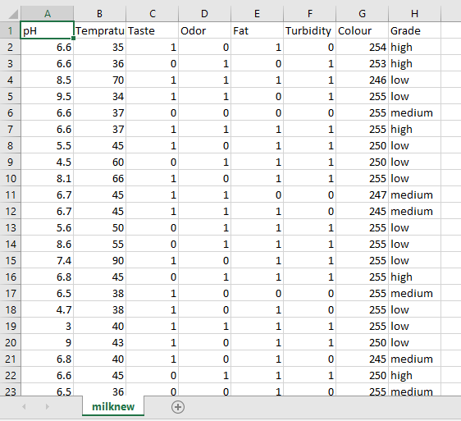
Data Set of Milk Quality

Slide 4
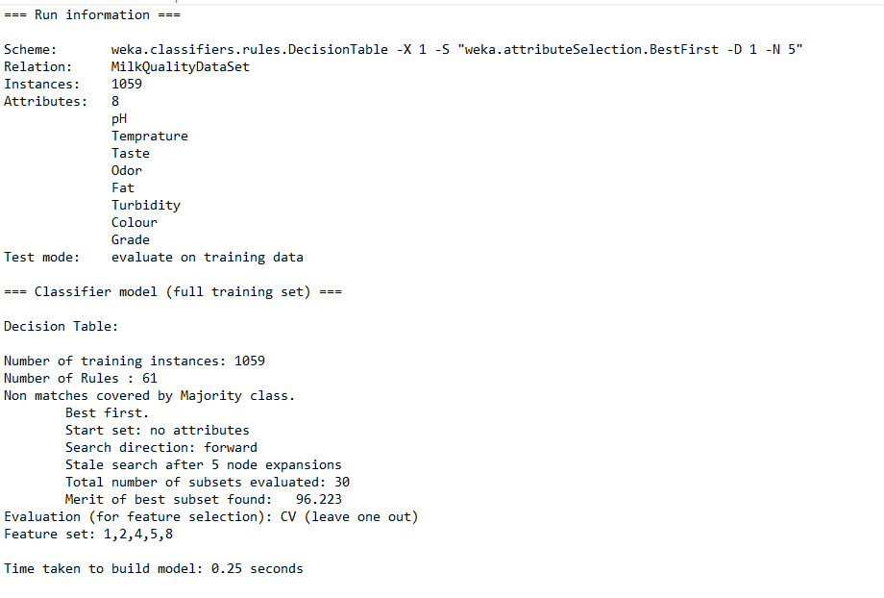
Decision Table

Slide 5
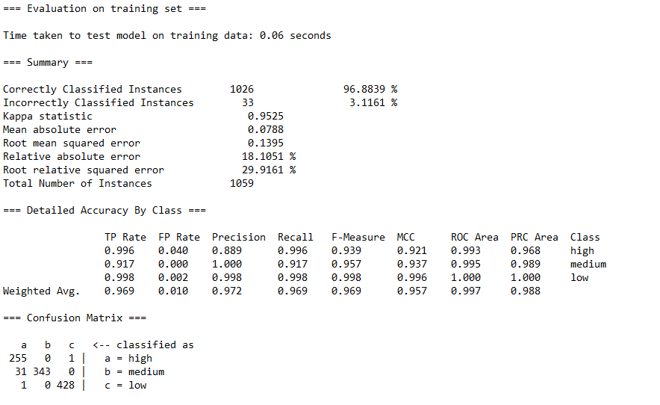
Decision Table

Slide 6
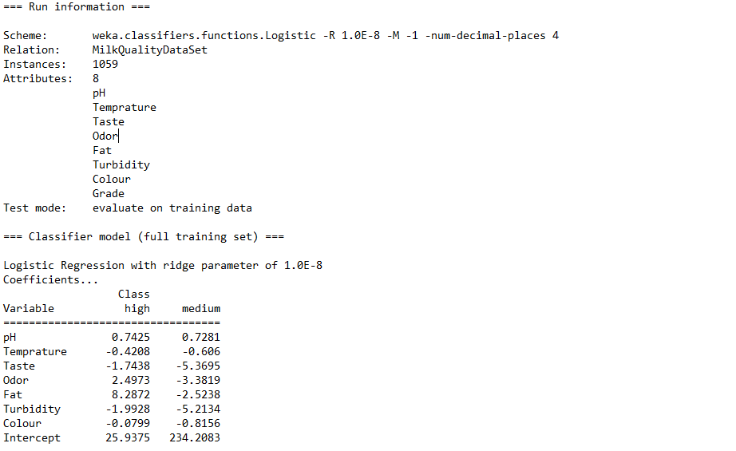
Logistic Regression

Slide 7
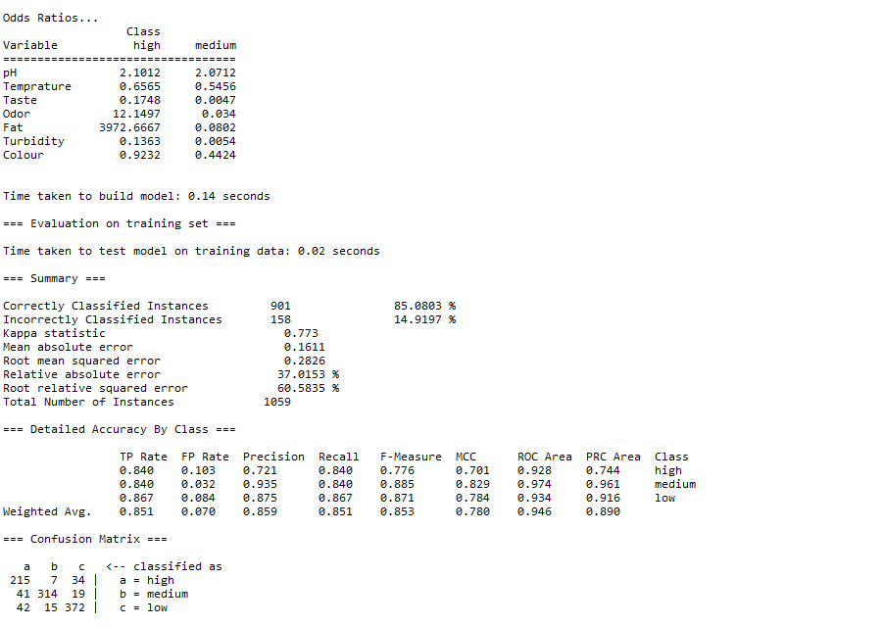
Logistic Regression

Slide 8
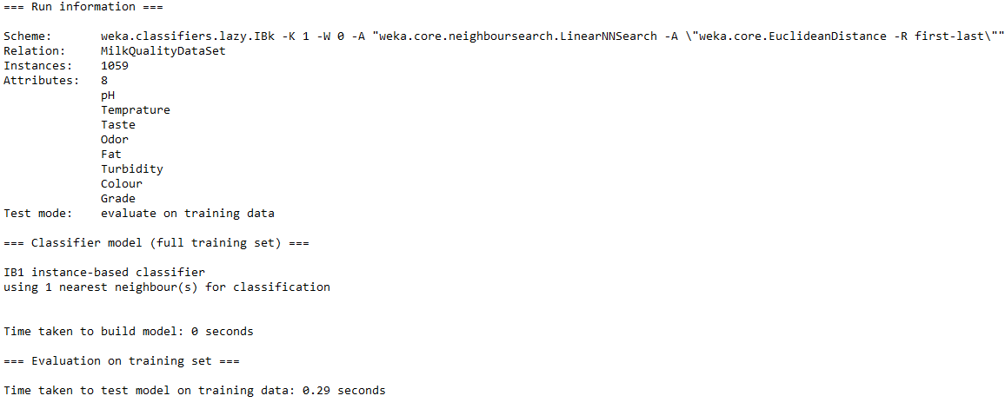
K- Nearest Neighbor

Slide 9
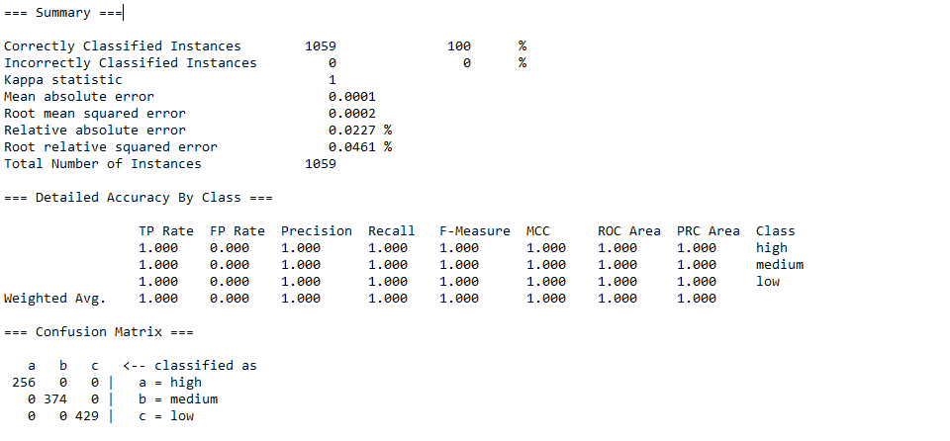
K- Nearest Neighbor

Slide 10
Comparison Of Applied Algorithms
ML Algo Name | TP (Weight Avg) | FP (Weight Avg) | Precision (Weight Avg) | Recall (Weight Avg) | Accuracy (Weight Avg)
Decision Tree | 0.969 | 0.01 | 0.97 | 0.969 | 96.88%
Logistic Regression | 0.851 | 0.07 | 0.859 | 0.851 | 85.08%
KNN | 1 | 0 | 1 | 1 | 100%

Slide 11
Applied Algorithms On Start-Up Company Profit Prediction
Linear Regression
K- Means Algorithm

Slide 12
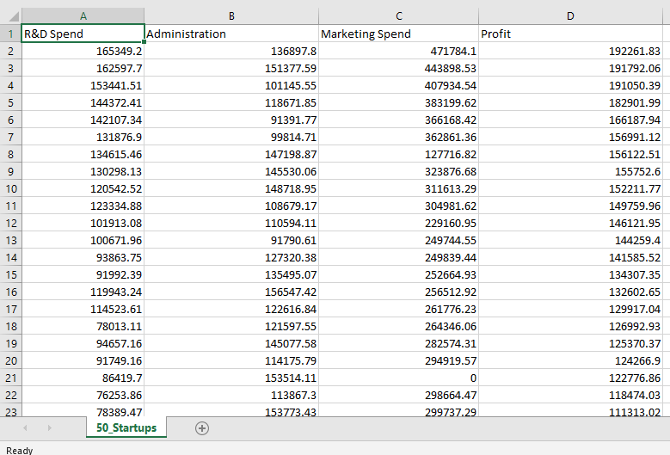
Data Set of Company Start Up

Slide 13
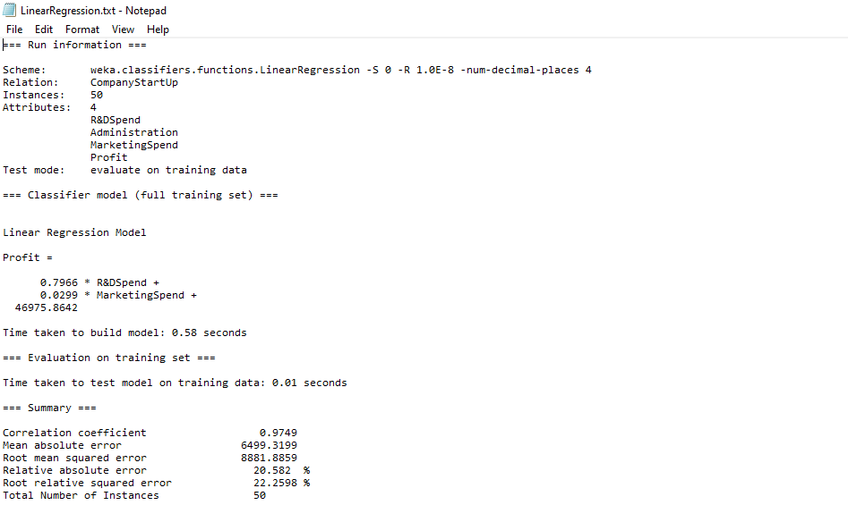
Linear Regression

Slide 14
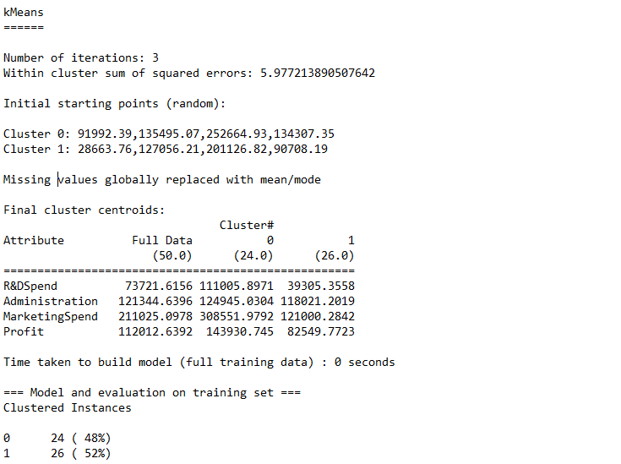
K- Means Algorithm

Slide 15
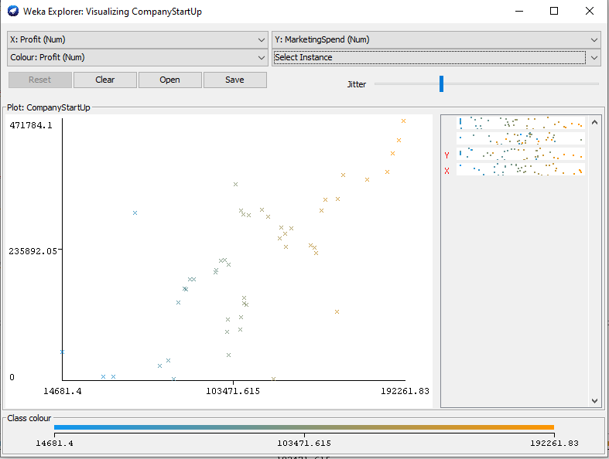
K- Means Algo, Graph Profit/Marketing Spend

Slide 16
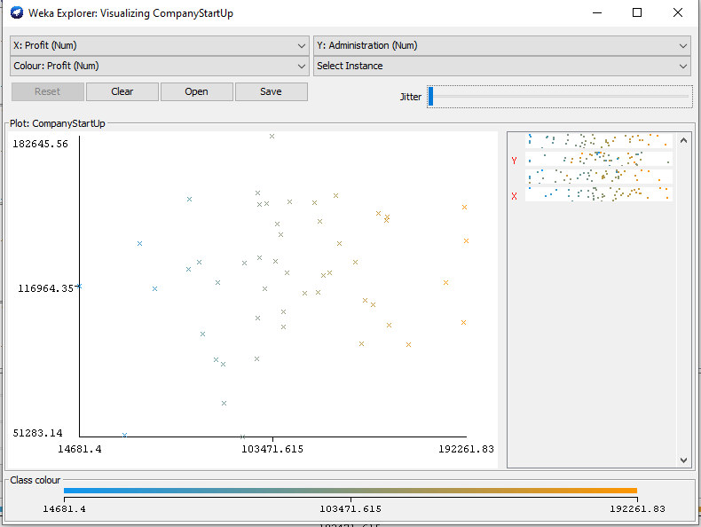
K- Means Algo, Graph Profit/Administration

Slide 17
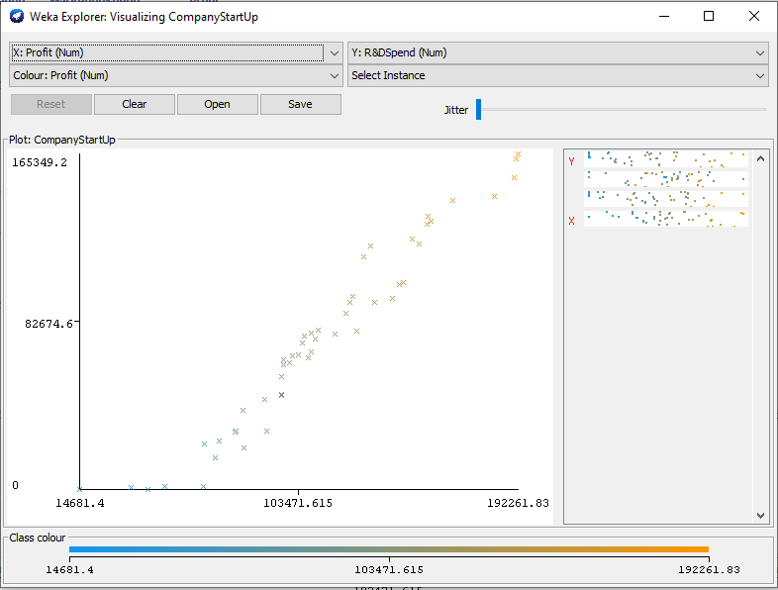
K- Means Algo, Graph Profit/R&D Spend

Slide 18
Thank You Everyone

